Slide 1
Mini Project on
Movie Ticket Management System
Submitted by :
Srinivas B (RA2111026010079), Arun A (RA2111026010076), Shanmugaraj K.P (RA2111026010096)
Course : CSE with Specialization in AIML

Slide 2
CONTENT
Aim
Abstract
Algorithm
Source code
Output
Result
Reference

Slide 3
AIM:
To manage all the information about the Consumer’s Name, Phone Number, Movie Name, Total Number of Tickets, Cost Per Ticket, Total Amount and to Store all Transactions.
ABSTRACT:
This system is based on the concept to generate the movie records and to add and update it.
User can add movie title with their ticket price and release date details safely.
Time is less consumed.
This system makes easy to store records of each and every employee.
This project uses different variables and strings for development.
Easy to operate and understand.

Slide 4
ALGORITHM:
Step 1 : Start the program.
Step 2 : Display operations.
Step 3 : Enter 1 to insert a movie and its details.
Step 4 : The details of the movies are stored in a separate file “data.txt” .
Step 5 : Enter 2 to view all the movies that have been inserted.
Step 6 : Enter 3 to find a particular movie by entering its Movie code.
Step 7 : Enter 4 to book a movie by entering the information of the customer and movie.
Step 8 : The transactions are stored in a separate file “oldTransaction.txt”
Step 9 : Enter 5 to view all the movie booking transactions.
Step 10 : Enter 0 to Exit the program.

Slide 5
PROGRAM SOURCE CODE:
#include<stdio.h>
#include<string.h>
#include<stdlib.h>
struct book
{
char code[20];
char name[20];
char date[20];
int cost;
}b;
int seat = 60 ;
void insert_details();

Slide 6
PROGRAM SOURCE CODE:
void viewAll();
void find();
void book_ticket();
void old_record();
void main()
{
int ch;
do{
printf("\n====================================================================");
printf("\n");
printf("\t Moive Ticket booking ");
printf("\n");

Slide 7
PROGRAM SOURCE CODE:
printf("\n====================================================================");
printf("\nPress <1> Insert Movie");
printf("\nPress <2> View All Movie");
printf("\nPress <3> Find Movie ");
printf("\nPress <4> Book Ticket");
printf("\nPress <5> View All Transections");
printf("\nPress <0> Exit ");
printf("\nEnter your Choice ::");
scanf("%d",&ch);
switch (ch)
{

Slide 8
PROGRAM SOURCE CODE:
case 1:
insert_details();
break;
case 2:
viewAll();
Break;
case 3:
find();
break;
case 4:
book_ticket();
break;

Slide 9
PROGRAM SOURCE CODE:
case 5:
old_record();
break;
case 0:
exit(0);
break;
default:
printf("Wrong choice !");
break;
}
}while(ch!=0);
}

Slide 10
PROGRAM SOURCE CODE:
void insert_details()
{
FILE *fp;
struct book b;
printf("Enter Movie Code :- ");
scanf("%s",b.code);
printf("Enter Movie Name :- ");
scanf("%s",b.name);
printf("Enter Release Date:- ");
scanf("%s",b.date);
printf("Enter Ticket Price:- ");
scanf("%d",&b.cost);

Slide 11
PROGRAM SOURCE CODE:
fp=fopen("data.txt","a");
if(fp == NULL)
{
printf("File not Found");
}
else
{
fprintf(fp,"%s %s %s %d \n",b.code,b.name,b.date,b.cost);
printf("Record insert Successful");
}
printf("\n");
fclose(fp);
}

Slide 12
PROGRAM SOURCE CODE:
void find()
{
struct book b;
FILE *fp;
char ch[20];
printf("Enter movie code :");
scanf("%s",ch);
fp = fopen("data.txt","r");
if(fp == NULL)
{
printf("File does not found !");
exit(1);

Slide 13
PROGRAM SOURCE CODE:
}
else
{
while(getc(fp) != EOF)
{
fscanf(fp,"%s %s %s %d",b.code,b.name,b.date,&b.cost);
if(strcmp(b.code,ch) == 0)
{
printf("%s / %s / %s / %d\n",b.code,b.name,b.date,b.cost);
printf("\n Record Found\n");
printf("\n\t\tMovie Code ::%s",b.code);
printf("\n\t\tMovie Name ::%s",b.name);
printf("\n\t\tMovie Date ::%s",b.date);

Slide 14
PROGRAM SOURCE CODE:
printf("\n\t\tPrice of Ticket::%d",b.cost);
break;
}
}
}
fclose(fp);
}
void viewAll()
{
char ch;
FILE *fp;
fp = fopen("data.txt","r");
if(fp == NULL)

Slide 15
PROGRAM SOURCE CODE:
{
printf("file does not found !");
exit(1);
}
else
{
while( ( ch = fgetc(fp) ) != EOF )
printf("%c",ch);
}
fclose(fp);
}

Slide 16
PROGRAM SOURCE CODE:
void book_ticket()
{
struct book b;
FILE *fp;
FILE *ufp;
int total_seat,mobile,total_amount;
char name[20];
char ch;
char movie_code[20];
fp = fopen("data.txt","r");
if(fp == NULL)

Slide 17
PROGRAM SOURCE CODE:
{
printf("file does not found !");
exit(1);
}
else
{
system("cls");
while( ( ch = fgetc(fp) ) != EOF )
printf("%c",ch);
}
fclose(fp);
printf("\n For Book ticket Choice Movie(Enter Movie Code First Letter Of Movie)\n");

Slide 18
PROGRAM SOURCE CODE:
printf("\n Enter movie code :");
scanf("%s",movie_code);
fp = fopen("data.txt","r");
if(fp == NULL)
{
printf("file does not found !");
exit(1);
}
else
{
while(getc(fp) != EOF)

Slide 19
PROGRAM SOURCE CODE:
{
fscanf(fp,"%s %s %s %d",b.code,b.name,b.date,&b.cost);
if(strcmp(b.code,movie_code) == 0)
{
printf("%s / %s / %s / %d\n",b.code,b.name,b.date,b.cost);
printf("\n Record Found\n");
printf("\n\t\tCode ::%s",b.code);
printf("\n\t\tMovie Name ::%s",b.name);
printf("\n\t\tMovie Date ::%s",b.date);
printf("\n\t\tPrice of Ticket ::%d",b.cost);
}
}
}

Slide 20
PROGRAM SOURCE CODE:
printf("\n* Fill Deatails *");
printf("\n Name :");
scanf("%s",name);
printf("\n Mobile number :");
scanf("%d",&mobile);
printf("\n Total number of tickets :");
scanf("%d",&total_seat);
total_amount = b.cost * total_seat;
printf("\n ***** ENJOY MOVIE ****\n");
printf("\n\t\tName : %s",name);
printf("\n\t\tMobile Number : %d",mobile);
printf("\n\t\tMovie name : %s",b.name);

Slide 21
PROGRAM SOURCE CODE:
printf("\n\t\tTotal seats : %d",total_seat);
printf("\n\t\tCost per ticket : %d",b.cost);
printf("\n\t\tTotal Amount : %d",total_amount);
ufp=fopen("oldTransection.txt","a");
if(ufp == NULL)
{
printf("File not Found");
}
else
{
fprintf(ufp,"%s %d %d %d %s %d \n", name, mobile, total_seat, total_amount, b.name, b.cost);

Slide 22
PROGRAM SOURCE CODE:
printf("\n Record insert Successful to the old record file");
}
printf("\n");
fclose(ufp);
fclose(fp);
}
void old_record()
{
char ch;
FILE *fp;
fp = fopen("oldTransection.txt","r");
if(fp == NULL)

Slide 23
PROGRAM SOURCE CODE:
{
printf("file does not found !");
exit(1);
}
else
{
while( ( ch = fgetc(fp) ) != EOF )
printf("%c",ch);
}
fclose(fp);
}

Slide 24
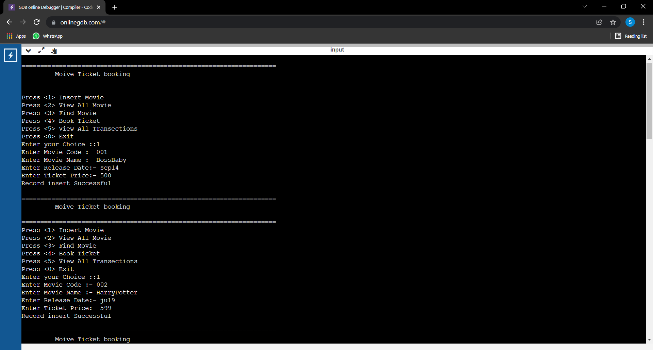
OUTPUT:

Slide 25
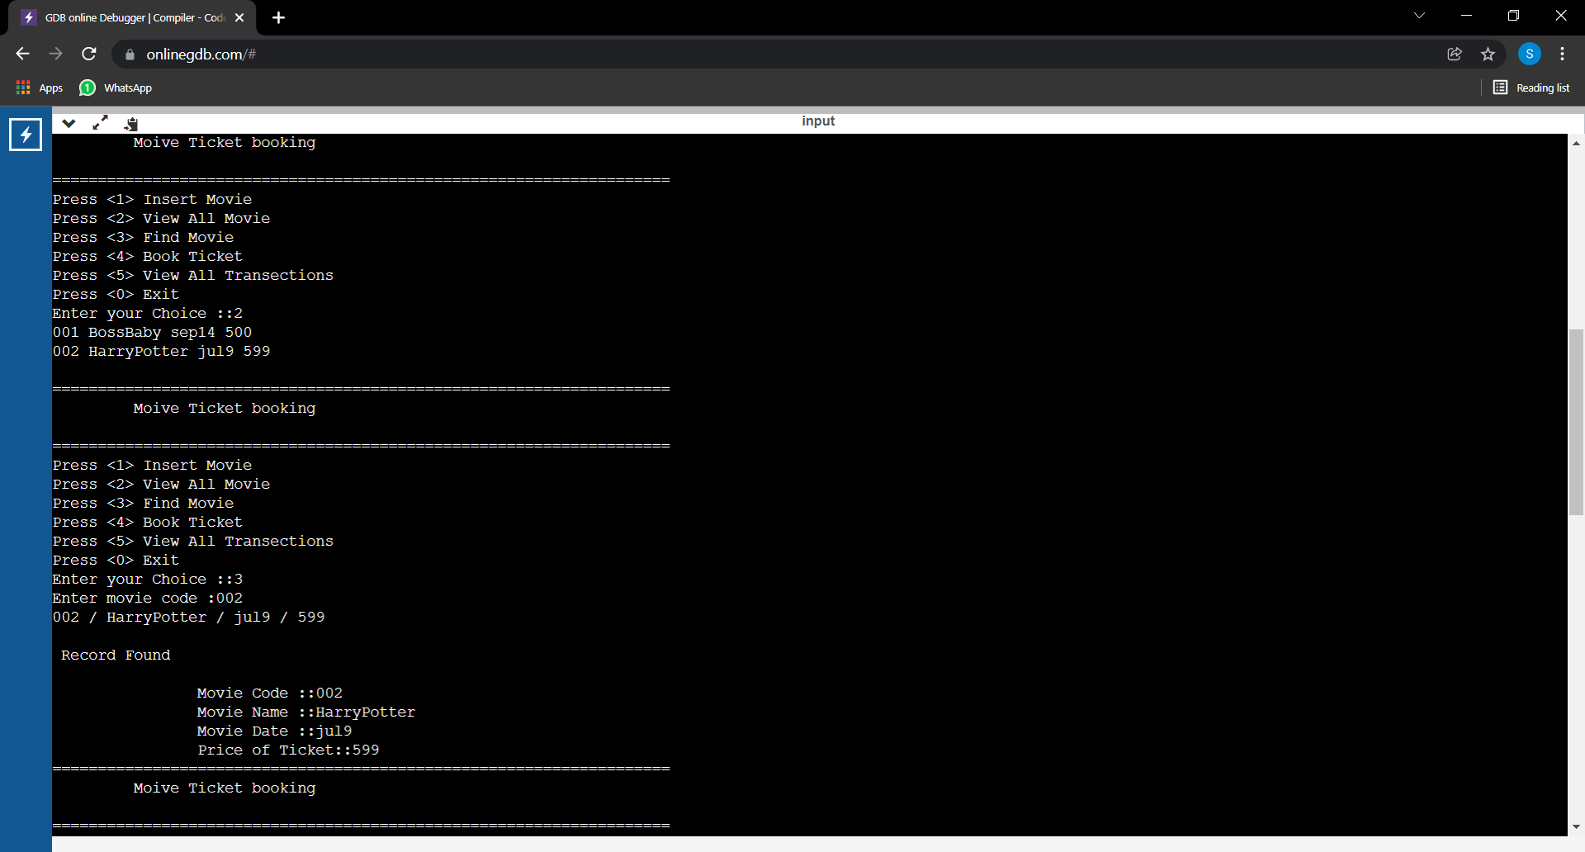
OUTPUT:

Slide 26
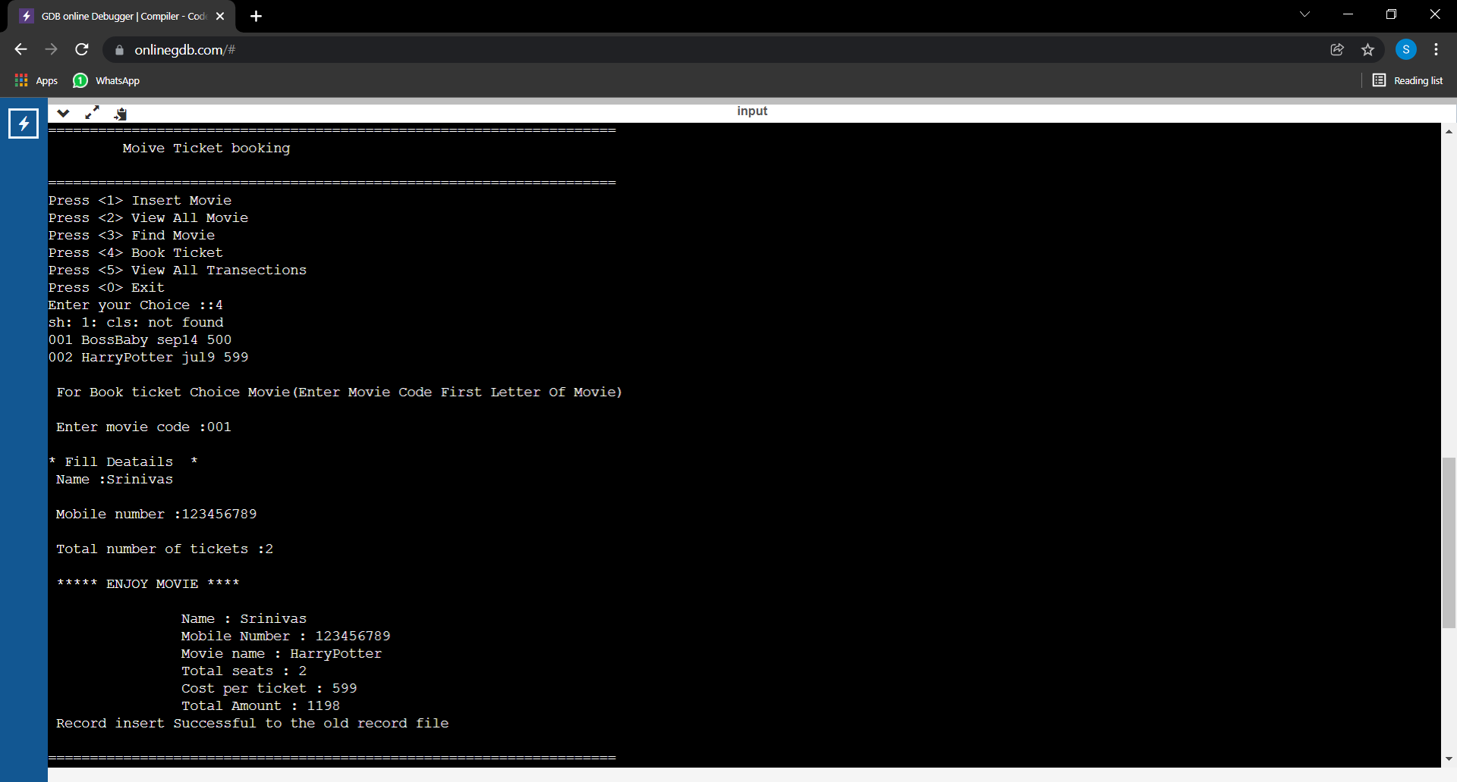
OUTPUT:

Slide 27
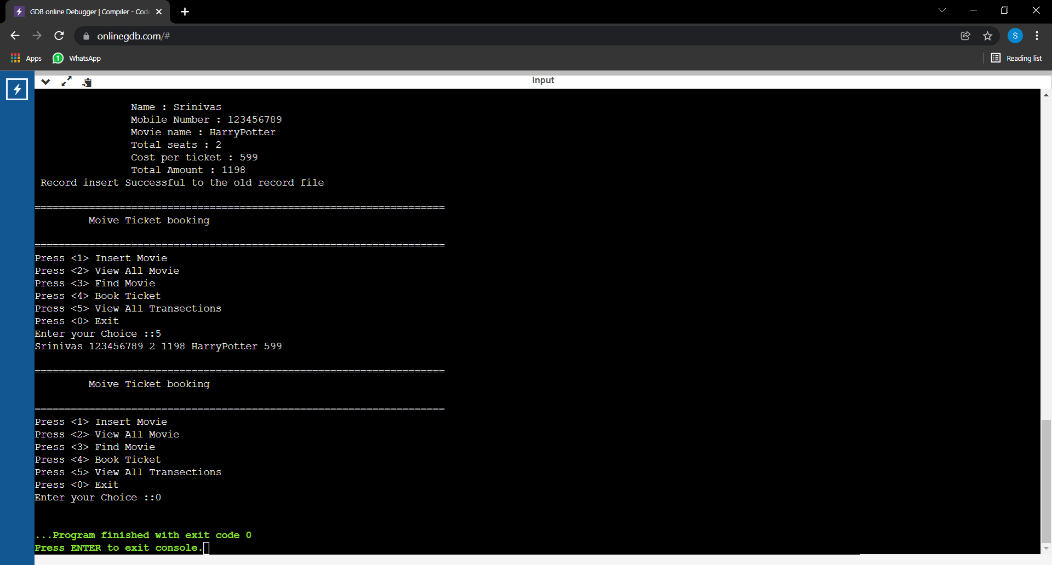
OUTPUT:

Slide 28
RESULT:
Thus the code is executed successfully and the outputs are verified. This will be a lot helpful to store all the information about the Consumer’s Name, Phone Number, Movie Name, Total Number of Tickets, Cost Per Ticket, Total Amount and to Store all Transactions.
REFERENCE:
CodeChef
JavaTpoint
Greekworld
Code Block

